Slide 1

Digital Marketing and Online Advertisement System

Slide 2
Introduction
Digital marketing connects with audiences across multiple online platforms like social media, search engines, email, and websites, ensuring businesses engage with consumers where they are most active.
It allows marketers to target specific audiences based on demographics, interests, and behaviors, ensuring ads reach the most relevant groups.
Digital marketing provides real-time analytics on campaign performance, allowing marketers to quickly adjust strategies based on metrics like impressions, click-through rates, and conversions.
Digital platforms offer flexible budgeting and bidding options, making it more affordable and efficient compared to traditional media.
Digital marketing enables personalized content delivery and ongoing optimization through A/B testing, leading to higher engagement and improved conversion rates.

Slide 3
Product Opportunity
Target Market: Small to medium-sized businesses (SMBs) looking to increase their online presence.
Pain Points: Difficulty in reaching the right audience, managing digital ads effectively, and high costs of advertising.
Product Idea: A digital marketing and online advertisement platform specifically designed for SMBs, offering cost-effective and targeted advertising solutions.

Slide 4
Proposed Digital Marketing Platform
Ad Creation Tools: Easy-to-use tools that allow SMBs to create engaging digital ads.
Audience Targeting: Advanced targeting options to ensure ads are shown to the most relevant audience.
Performance Analytics: Insights into ad performance to help optimize campaigns for better results.
Budget Management: Tools to help SMBs control their advertising expenses effectively.
Ease of Use: Designed to be user-friendly and accessible, even for those with limited technical expertise.

Slide 5
Value Proposition
Our platform simplifies the process of creating and managing online ads, making it accessible for SMBs.
Provides advanced targeting tools to improve ad reach and effectiveness.
Reduces advertising costs through optimized ad spending strategies.
Empowers SMBs to efficiently connect with their ideal audience through cost-effective digital marketing solutions.

Slide 6
Customer 1: Bright Media Solutions
Ad Campaign​
How would you describe the primary goal of your current ad campaigns?​ To increase brand awareness and drive traffic to our website through social media and email marketing.​
What platforms are you currently using for your ad campaigns?​ We are using Facebook Ads, Google Ads, and Mailchimp.​
What challenges have you faced with your current audience targeting strategies?​ Difficulty in narrowing down the audience to those who are more likely to convert, leading to wasted ad spend.​
Complexity and Cost​
How would you rate the overall complexity of the ad platforms you are currently using?​ Somewhat complex, particularly when trying to integrate data from multiple sources.​
What specific features or aspects of these platforms do you find most complex or challenging to use?​ Tracking ROI across different channels and managing multiple ad accounts is challenging.​
What is your monthly budget for digital advertising, and how does it compare to the actual costs you are incurring on these platforms?​ Our budget is around $1,500, but we often exceed it due to inefficient targeting.​
What specific features or functionalities would you like to see in a simpler ad platform?​ An all-in-one solution that integrates various channels and simplifies ROI tracking.​
​
Analytics​
What tools are you currently using to analyze the performance of your ad campaigns?​ We use Google Analytics and built-in analytics from Facebook and Mailchimp.​
What specific challenges are you facing with your current analytics tools?​ It’s difficult to get a unified view of performance across different platforms.​
What features would you find most beneficial in a new analytics tool?​ Cross-platform performance tracking and simplified reporting.​
Integration​
What specific functionalities would you like the integrated platform to have?​ Seamless integration of social media, email marketing, and SEO tools.​
What types of data do you currently track in your CRM system?​ We track customer engagement, conversion rates, and email open rates.​
Localization​
Are you currently running any localized ad campaigns?​ Not specifically, but we occasionally target certain regions for specific promotions.​
What metrics are most important to you when evaluating the success of localized ad campaigns?​ Engagement rates and conversion rates from specific regions.​
How granular do you want the geographic targeting to be?​ We would like to target by city or even neighbourhood level.​

Slide 7
Customer 2: Urban Style Boutique
Ad Campaign​
How would you describe the primary goal of your current ad campaigns?​ To drive foot traffic to our physical store and increase online sales.​
What platforms are you currently using for your ad campaigns?​ We primarily use Facebook Ads and Instagram for promotions.​
What challenges have you faced with your current audience targeting strategies?​ Difficulty targeting local customers effectively and managing ad spend.​
Complexity and Cost​
How would you rate the overall complexity of the ad platforms you are currently using?​ The platforms are relatively straightforward, but managing costs is challenging.​
What specific features or aspects of these platforms do you find most complex or challenging to use?​ Budget management tools are difficult to use effectively.​
What specific features or functionalities would you like to see in a simpler ad platform?​ More intuitive budget controls and better local targeting options​
Analytics​
What tools are you currently using to analyse the performance of your ad campaigns?​ Facebook Insights and Google Analytics.​
What specific challenges are you facing with your current analytics tools?​ It’s hard to connect online ads to in-store visits.​
What features would you find most beneficial in a new analytics tool?​ Tools that can track the impact of online ads on offline sales.​
Integration​
What specific functionalities would you like the integrated platform to have?​ Integration with our email marketing and social media tools.​
What types of data do you currently track in your CRM system?​ Customer purchase history and engagement with email campaigns.​
Have you experienced any challenges with previous integrations between ad platforms and your CRM system? If so, please describe.​ Yes, data from social media platforms doesn’t always sync well with our CRM.​
Localization​
Are you currently running any localized ad campaigns?​ Yes, we target local customers for store events and promotions.​
What metrics are most important to you when evaluating the success of localized ad campaigns?​ In-store foot traffic and local online sales.​
How granular do you want the geographic targeting to be?​ We’d like to target specific neighbourhoods within our city.​

Slide 8
Customer 3: Innovatech Solutions
Ad Campaign​
How would you describe the primary goal of your current ad campaigns?​ To generate high-quality leads for our B2B services.​
What platforms are you currently using for your ad campaigns?​ Google Ads, LinkedIn Ads, and content marketing.​
What challenges have you faced with your current audience targeting strategies?​ Difficulty in reaching decision-makers and generating qualified leads.​
Complexity and Cost​
How would you rate the overall complexity of the ad platforms you are currently using?​ High complexity, especially in managing LinkedIn Ads.​
What specific features or aspects of these platforms do you find most complex or challenging to use?​ Managing bids and targeting for B2B audiences is particularly challenging.​
What is your monthly budget for digital advertising, and how does it compare to the actual costs you are incurring on these platforms?​ We budget around $3,000, but LinkedIn Ads often exceed this.​
Analytics​
What tools are you currently using to analyse the performance of your ad campaigns?​ HubSpot, Google Analytics, and native LinkedIn Analytics.​
What specific challenges are you facing with your current analytics tools?​ It’s difficult to track the customer journey across different platforms.​
What features would you find most beneficial in a new analytics tool?​ Cross-platform attribution tracking and lead scoring.​
Integration​
What specific functionalities would you like the integrated platform to have?​ Integration with our CRM and lead management tools.​
What types of data do you currently track in your CRM system?​ Lead sources, engagement metrics, and sales pipeline data.​
Have you experienced any challenges with previous integrations between ad platforms and your CRM system? If so, please describe.​ Yes, the lack of integration between LinkedIn and our CRM is a major issue.​
Localization​
Are you currently running any localized ad campaigns?​ No, our focus is on a global audience.​
What metrics are most important to you when evaluating the success of localized ad campaigns?​ N/A​
How granular do you want the geographic targeting to be?​ We do not prioritize geographic targeting.​

Slide 9
Customer 4: Taste Town Restaurant
Ad Campaign​
How would you describe the primary goal of your current ad campaigns?​ To increase in-store visits and promote special events.​
What platforms are you currently using for your ad campaigns?​ Facebook Ads, Instagram, and Foursquare.​
What challenges have you faced with your current audience targeting strategies?​ Reaching the local community effectively and tracking ad impact on in-store visits.​
Complexity and Cost​
How would you rate the overall complexity of the ad platforms you are currently using?​ Moderately complex, especially with local targeting.​
What specific features or aspects of these platforms do you find most complex or challenging to use?​ Local targeting and measuring offline conversions.​
What is your monthly budget for digital advertising, and how does it compare to the actual costs you are incurring on these platforms?​ We budget around $500, but unexpected costs often arise.​
Analytics​
What tools are you currently using to analyse the performance of your ad campaigns?​ Facebook Insights and Google Analytics.​
What specific challenges are you facing with your current analytics tools?​ It’s hard to link online ads to actual in-store visits.​
What features would you find most beneficial in a new analytics tool?​ Tools that can directly correlate online ad spend to in-store traffic.​
Integration​
What specific functionalities would you like the integrated platform to have?​ Integration with our reservation system and customer feedback tools.​
What types of data do you currently track in your CRM system?​ Customer reservations, feedback, and event participation.​
Have you experienced any challenges with previous integrations between ad platforms and your CRM system? If so, please describe.​ Yes, there are issues with syncing data from Foursquare with our CRM.​
​
Localization​
Are you currently running any localized ad campaigns?​ Yes, we target local customers for restaurant promotions.​
What metrics are most important to you when evaluating the success of localized ad campaigns?​ Increase in reservations and in-store traffic.​
How granular do you want the geographic targeting to be?​ We would like to target specific neighbourhoods and zip codes.​

Slide 10
Customer 5: Focus Marketing Solutions
Ad Campaign​
How would you describe the primary goal of your current ad campaigns?​ To increase patient bookings and promote new health services.​
What platforms are you currently using for your ad campaigns?​ Google Ads, Facebook Ads, and local health directories.​
What challenges have you faced with your current audience targeting strategies?​ Difficulty reaching specific demographics and managing ad spend.​
Complexity and Cost​
How would you rate the overall complexity of the ad platforms you are currently using?​ Moderately complex, especially with demographic targeting.​
What specific features or aspects of these platforms do you find most complex or challenging to use?​ Demographic targeting and cost management.​
What is your monthly budget for digital advertising, and how does it compare to the actual costs you are incurring on these platforms?​ We budget around $2,000, but ad costs often exceed this.​
What specific features or functionalities would you like to see in a simpler ad platform?​ More effective demographic targeting and better budget controls.​
Analytics​
What tools are you currently using to analyse the performance of your ad campaigns?​ Google Analytics and Facebook Insights.​
What specific challenges are you facing with your current analytics tools?​ Tracking patient bookings back to specific ads is difficult.​
What features would you find most beneficial in a new analytics tool?​ Conversion tracking that links directly to patient appointments.​
Integration​
What specific functionalities would you like the integrated platform to have?​ Integration with our appointment scheduling system and patient management tools.​
What types of data do you currently track in your CRM system?​ Patient demographics, appointment history, and service usage.​
Have you experienced any challenges with previous integrations between ad platforms and your CRM system? If so, please describe.​ Yes, syncing data between Google Ads and our patient management system is inconsistent.​
Localization​
Are you currently running any localized ad campaigns?​ Yes, we target specific neighbourhoods and communities.​
What metrics are most important to you when evaluating the success of localized ad campaigns?​ Patient bookings and inquiries from targeted areas.​
How granular do you want the geographic targeting to be?​ We want to target by neighbourhood and even by specific streets.​

Slide 11
Key Learnings from Customer Interviews
Desire for Integration: Many customers are interested in an all-in-one platform that integrates various digital marketing tools, including social media, email marketing, content marketing, and analytics. This would simplify management and reduce the need for multiple tools.
Cost Sensitivity: Budget constraints are a common challenge, with customers looking for affordable solutions that offer flexible pricing and good value for money. There is a preference for tools that scale with business size or ad spend.
Targeting and ROI Tracking: Effective targeting, especially local targeting, is a significant pain point. Customers want better tools for precise audience targeting and robust ROI tracking to optimize ad spending.
Ease of Use and Support: There is a need for a user-friendly platform that offers in-platform guidance and customer support, particularly for targeting and campaign optimization. Customers prefer platforms that are straightforward and do not require a steep learning curve.
Scalability and Advanced Features: Customers are looking for solutions that can grow with their businesses, offering advanced features and integrations as their needs evolve, without the need to switch platforms.
Efficient Client Reporting: For agencies, efficient and clear client reporting is critical. A platform with built-in reporting capabilities that can easily generate professional reports would be highly valuable.

Slide 12
Product Idea Refinement
Based on customer feedback, the product idea was refined to include:
Enhanced audience targeting capabilities
Simplified user interface for easier ad creation
Robust analytics dashboard for performance insights
Seamless integration with popular CRM tools
Localization features for targeting ads geographically

Slide 13
Final Product Description
Product Name: AdPro SMB
Description: An easy-to-use digital marketing platform for SMBs to create, manage, and optimize digital ads. It maximizes reach and return on investment (ROI) with minimal cost by offering advanced targeting tools, a user-friendly interface, integrated analytics, and seamless CRM integration.
Benefits: Cost-effective, improves ad reach and engagement, simplifies ad management, and provides valuable insights through analytics.

Slide 14
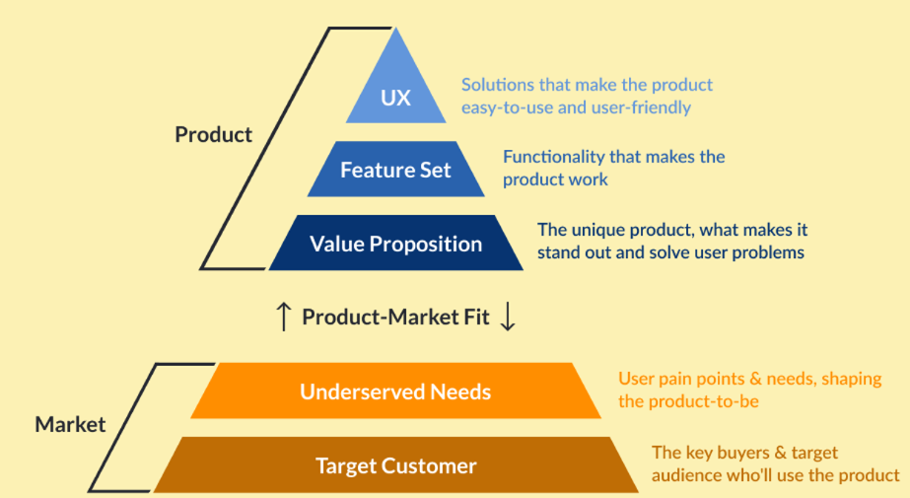
Product-Market Fit Pyramid
Target Customer: SMBs looking for cost-effective digital marketing solutions.
Underserved Needs: Effective audience targeting, cost control, simplified ad management, and integration with existing tools.
Value Proposition: A cost-effective, user-friendly digital marketing and online advertisement system with advanced targeting and analytics capabilities.

Slide 15
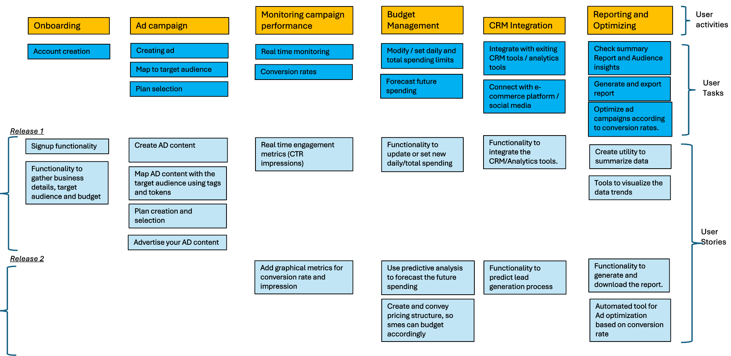
Story Map

Slide 16
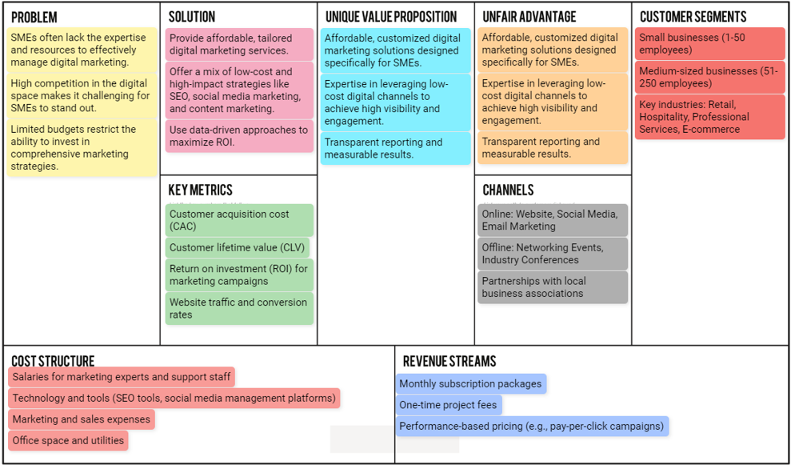
Business Plan : Canvas

Slide 17
Key Learnings : Harmalkar Rahul Rajan Sayali
Strategic Integration: A successful digital marketing strategy requires the integration of various tools and platforms. This unified approach ensures consistent messaging and more effective campaign execution.
Consumer-Centric Approach: Understanding and adapting to consumer behavior is paramount. Personalized and targeted campaigns based on consumer data significantly enhance engagement and conversion rates.
Data-Driven Decision Making: The importance of real-time analytics and data cannot be overstated. Continuous measurement and analysis allow businesses to make informed decisions, optimize their strategies, and achieve better results.
Adoption of Advanced Technologies: AI and machine learning are reshaping digital marketing, providing deeper insights, improved targeting, and more efficient resource allocation.
Future-Ready Strategies: Staying updated with trends such as video marketing and AI-driven personalization is essential for maintaining a competitive edge in the fast-evolving digital landscape.

Slide 18
Conclusion
Digital marketing and online advertisement systems are essential components of modern business strategies. They enable companies to reach a global audience, engage customers effectively, and drive growth. This presentation highlighted the key aspects of digital marketing, including its core components like SEO, SEM, social media marketing, and content marketing. It also covered various types of online advertisement systems, such as PPC, display ads, and social media ads, which play a crucial role in enhancing brand visibility and driving conversions.
The discussion emphasized the challenges faced by marketers, such as competition, ad saturation, and the complexity of measuring ROI. These challenges underline the importance of advanced targeting, personalization, and the integration of new technologies like AI and machine learning in online advertising. Additionally, the presentation explored the significance of cross-platform integration, ensuring that marketing efforts are consistent across all digital channels.
The future of digital marketing will be shaped by emerging trends, including increased personalization, the growth of video marketing, and the use of AI to predict consumer behavior. Marketers must stay ahead of these trends to maintain a competitive edge.
Overall, the key to successful digital marketing lies in understanding the digital landscape, effectively targeting and engaging the audience, and continuously adapting to the evolving market dynamics. By leveraging data-driven insights and advanced technologies, businesses can create more effective campaigns, improve customer experiences, and achieve better outcomes in the digital space.

Slide 19
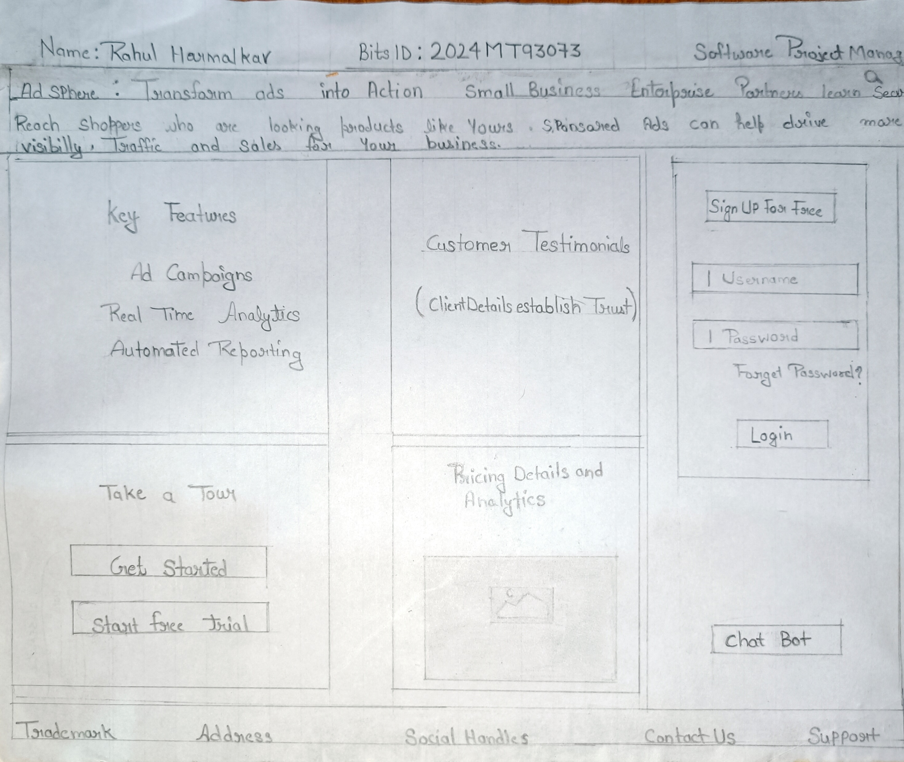
Hand Drawn Sketch by Team​

Slide 20
Summary
Introduction to DMOAS​
Overview:​
The Digital Marketing and Online Advertisement System (DMOAS) is a unified platform designed to streamline ad campaign management, audience targeting, and performance analysis.​
​
Purpose:​
To manage, optimize, and analyze digital ad campaigns across various channels, improving marketing efficiency and impact.

Slide 21


